Slide 1
MONO COUNTY
CITIZENS WILDFIRE ACADEMY
DAVID HAAS
CAL FIRE
SAN BERNARDINO UNIT FORESTER
JUNE 20, 2022
CAL FIRE

Slide 2
MONO COUNTY
CITIZENS WILDFIRE ACADEMY
WHO ARE WE?
WHERE DO WE WORK?
WHAT DO WE DO…?
PRE-FIRE
DURING AN INCIDENT
AFTER AN INCIDENT
CAL FIRE

Slide 3
CAL FIRE
California Department of Forestry & Fire Protection
State’s Fire Department
Resource Management
Office of the State Fire Marshal
Incident Management
Mission: The Department of Forestry and Fire Protection serves and safeguards the people and protects the property and resources of California
CAL FIRE

Slide 4
CAL FIRE
21 Administrative Units
Divided into 2 Regions
6 Contract Counties
Kern
Los Angeles
Marin
Orange
Santa Barbara
Ventura
CAL FIRE

Slide 5
SAN BERNARDINO UNIT
San Bernardino, Inyo, & Mono Counties
Administrative Unit for LA County
1 Fire Center
4 Conservation Camps
13 Stations
2 Municipal Contracts:
City of Highland
City of Yucaipa
CAL FIRE

Slide 6
JURISDICTION
Responsibility Area
Assigns financial responsibility of preventing & suppressing fires
State Responsibility Area
~ 31 million acres of privately-owned wildlands
Lands covered wholly or in part by forests or by trees producing or capable of producing forest products
Lands covered wholly or in part by timber, brush, undergrowth, or grass, whether of commercial value or not, which protect the soil from excessive erosion, retard runoff of water or accelerate water percolation, if such lands are sources of water which is available for irrigation or for domestic or industrial use.
CALFIRE

Slide 7
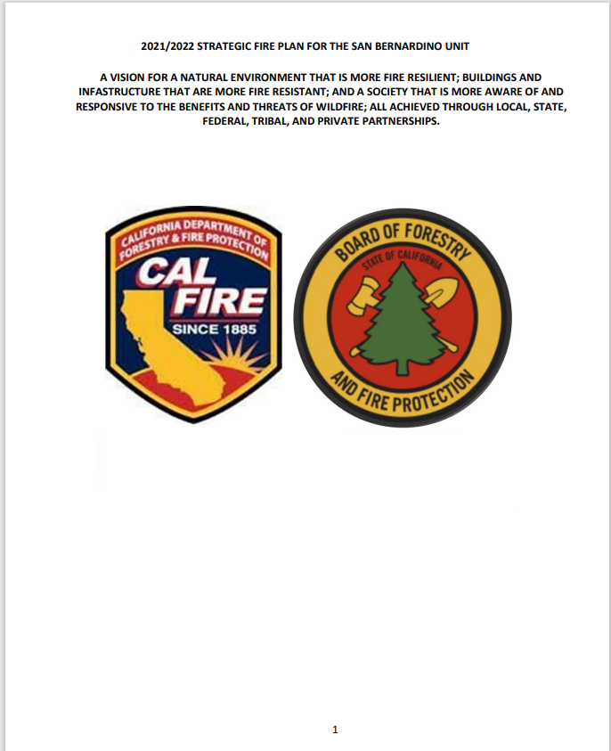
WHAT DO WE DO?
PRE-FIRE
UNIT FIRE PLAN:
Address how the Unit is achieving goals & objectives of Department’s Strategic Fire Plan
Updated annually
https://osfm.fire.ca.gov/divisions/community-wildfire-preparedness-and-mitigation/fire-plan/
OR
GOOGLE: OSFM UNIT FIRE PLAN
CAL FIRE

Slide 8
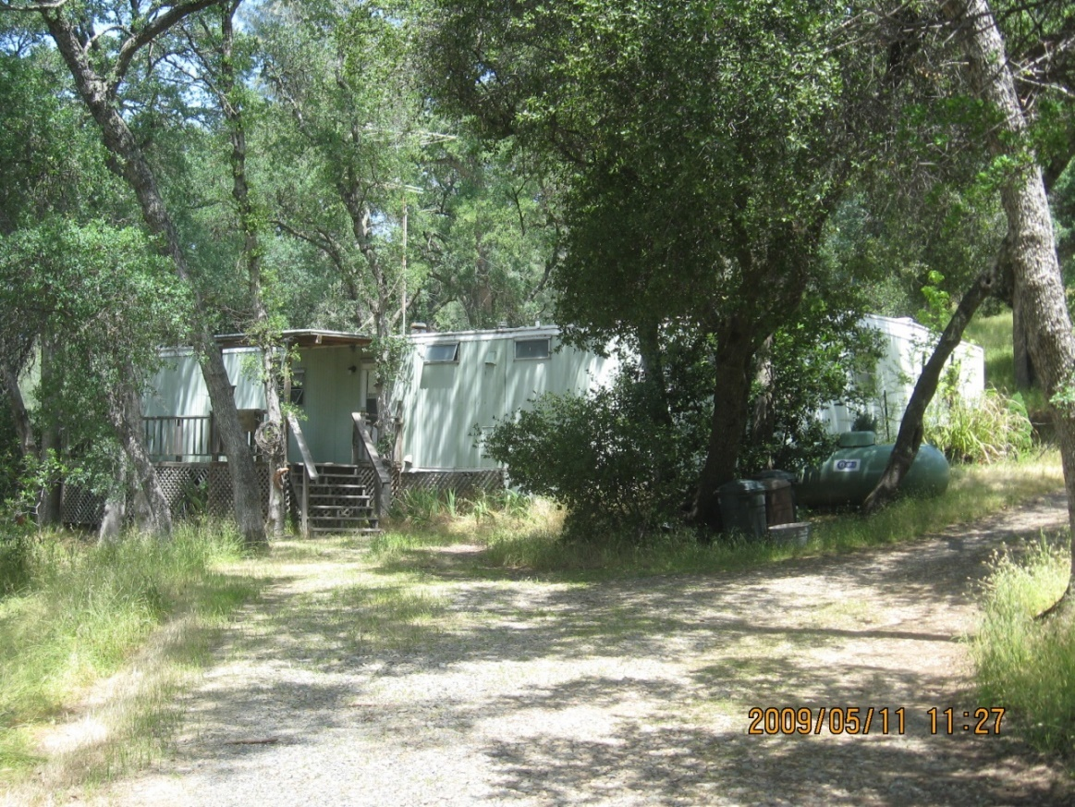
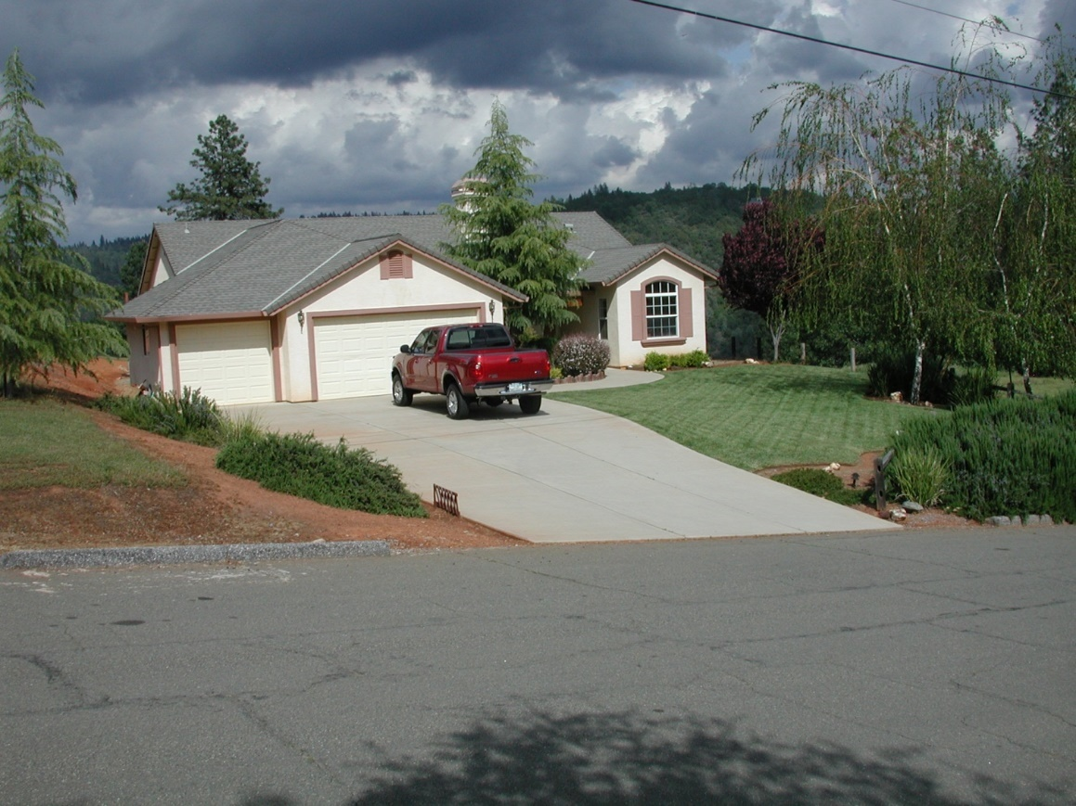
WHAT DO WE DO?
PRE-FIRE
DEFENSIBLE SPACE INSPECTIONS WITHIN SRA – CA PRC 4291
CALFIRE

Slide 9
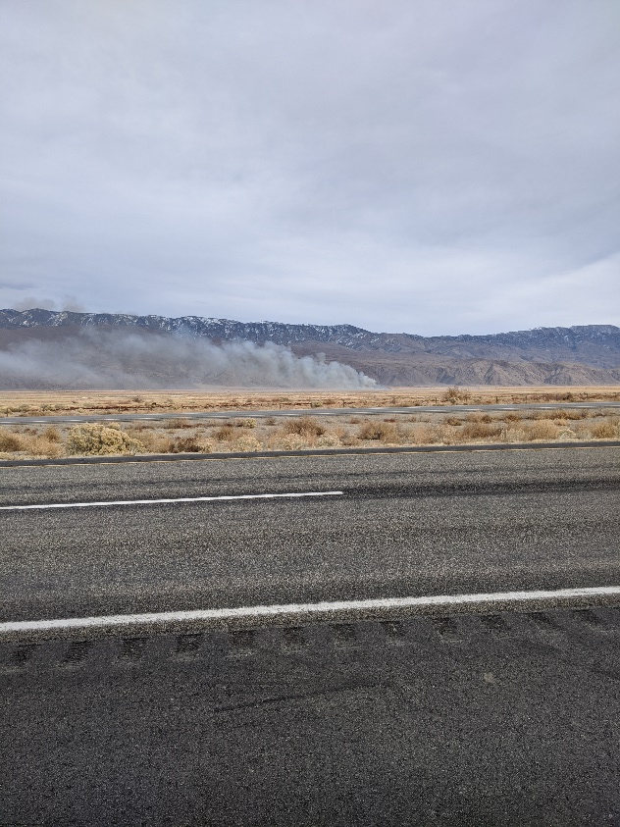
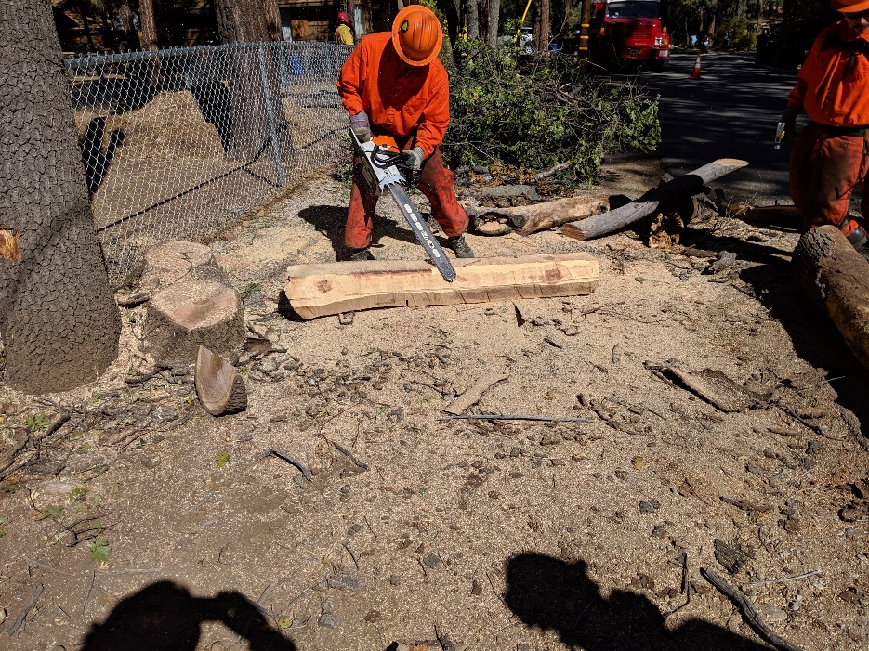
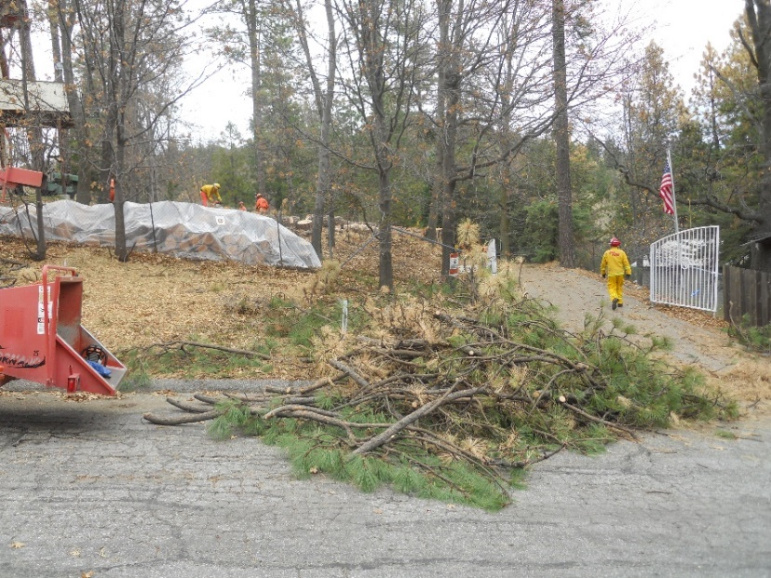
WHAT DO WE DO?
PRE-FIRE
Internally funded fuel reduction projects
Vegetation Management Program/Prescribed burning
CAL FIRE

Slide 10
WHAT DO WE DO?
PRE-FIRE
ENFORCE SRA FIRE SAFE REGULATIONS
CA CODE OF REGULATIONS (CCR) §1270-1276
FUEL MODIFICATION STANDARDS
§1276
EMERGENCY WATER STANDARDS
§1275
§1274
EMERGENCY ACCESS & EGRESS
§1273
SIGNING & BUILDING NUMBERING
CAL FIRE

Slide 11
WHAT DO WE DO?
PRE-FIRE
GRANTS!!
FIRE PREVENTION
URBAN & COMMUNITY FORESTRY
CALIFORNIA FOREST IMPROVEMENT PROGRAM
FOREST HEALTH
VOLUNTEER FIRE ASSISTANCE
CAL FIRE

Slide 12
WHAT DO WE DO?
PRE-FIRE
Office of the State Fire Marshal
Building codes
Pipeline safety
Land Use Planning
Fire hazard zone severity maps
State fire training
CAL FIRE

Slide 13
WHAT DO WE DO?
PRE-FIRE
CAL FIRE mandated by PRC 4201 – 4204 & GC 51175 – 89 to identify FHSZ statewide
Separate FHSZ maps for SRA & LRA
SRA:
Moderate
High
Very High
LRA
Very High
CALFIRE

Slide 14
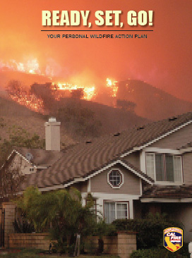
WHAT DO WE DO?
PRE-FIRE
Public outreach & education
Readyforwildfire.org
CAL FIRE

Slide 15
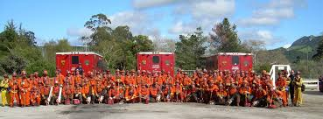
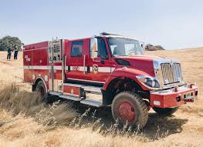
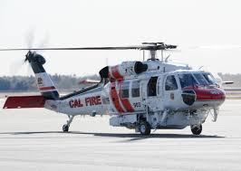
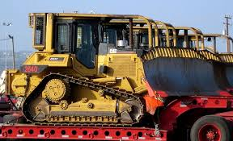
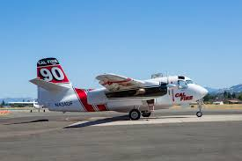
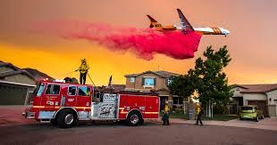
WHAT DO WE DO?
DURING AN INCIDENT
FIRE
SUPPRESSION
CALFIRE

Slide 16
WHAT DO WE DO?
DURING AN INCIDENT
INCIDENT MANAGEMENT
Incident Commander
Public Information Officer
Finance Section
Logistics Section
Planning Section
Operations Section
Safety Officer
Liaison Officer
COMMAND STAFF
GENERAL STAFF
CAL FIRE

Slide 17
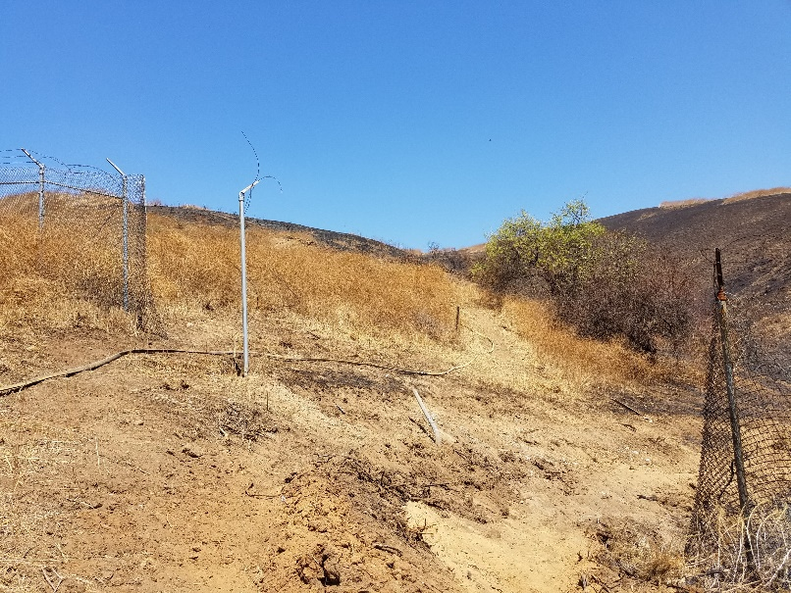
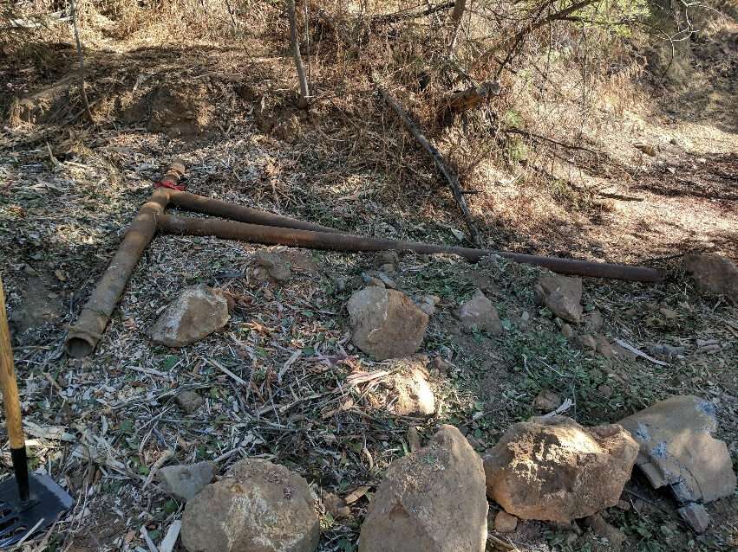
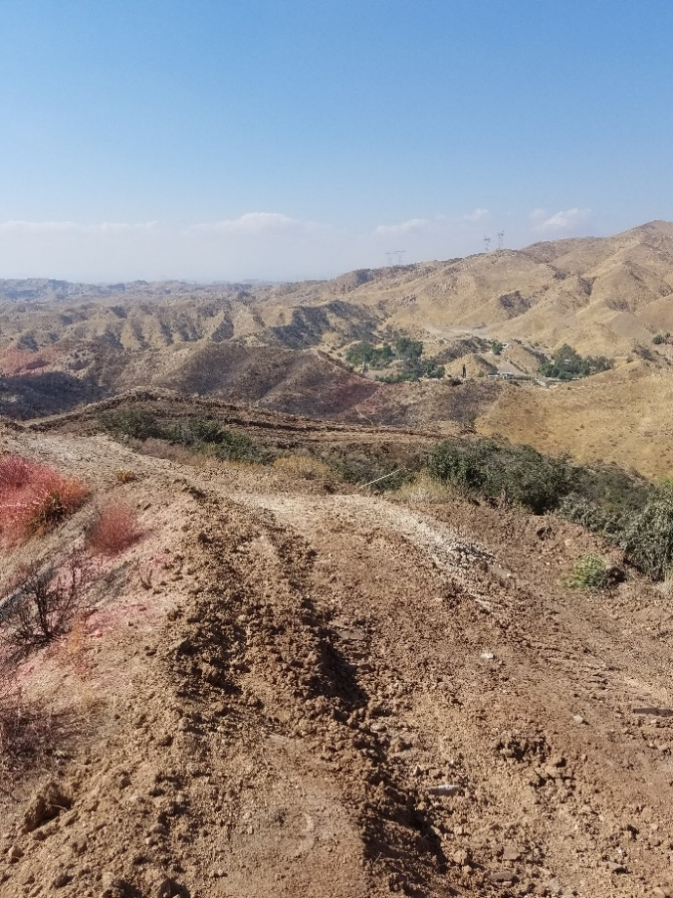
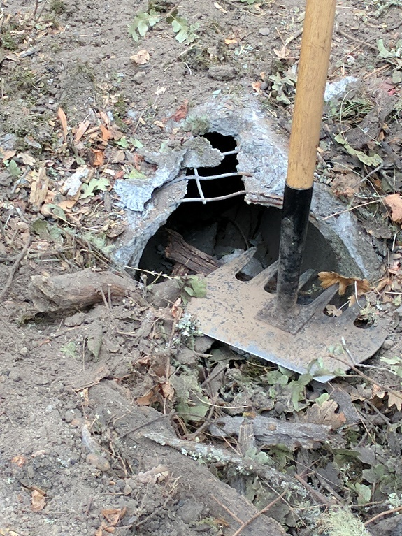
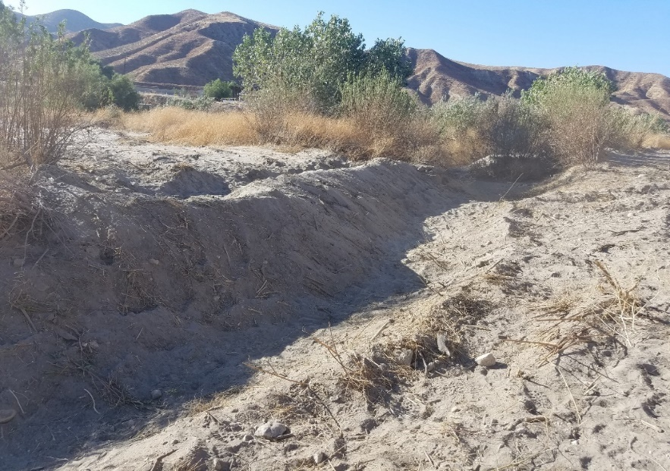
WHAT DO WE DO?
AFTER AN INCIDENT
SUPPRESSION REPAIR
CALFIRE

Slide 18
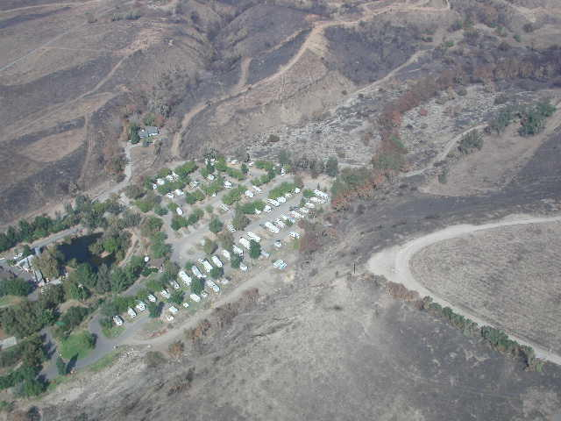
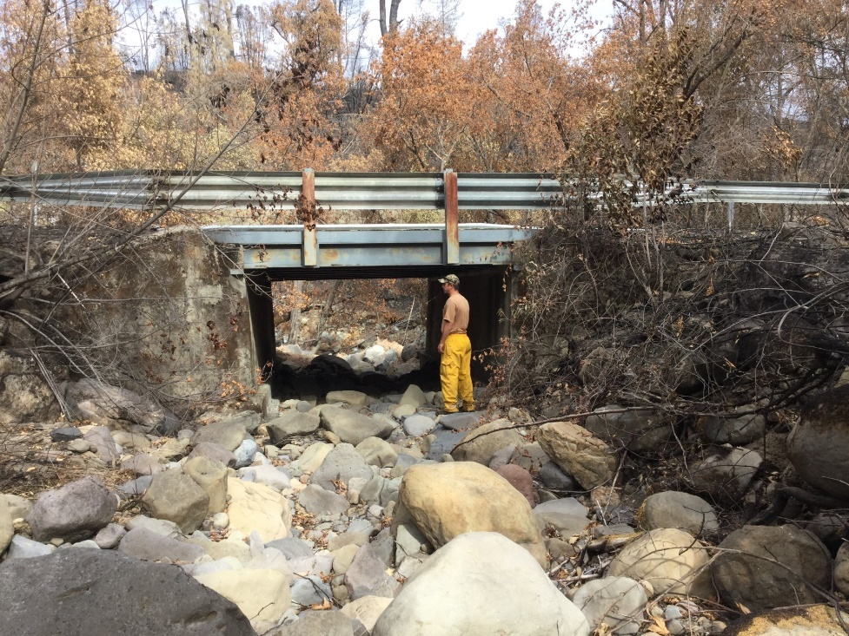
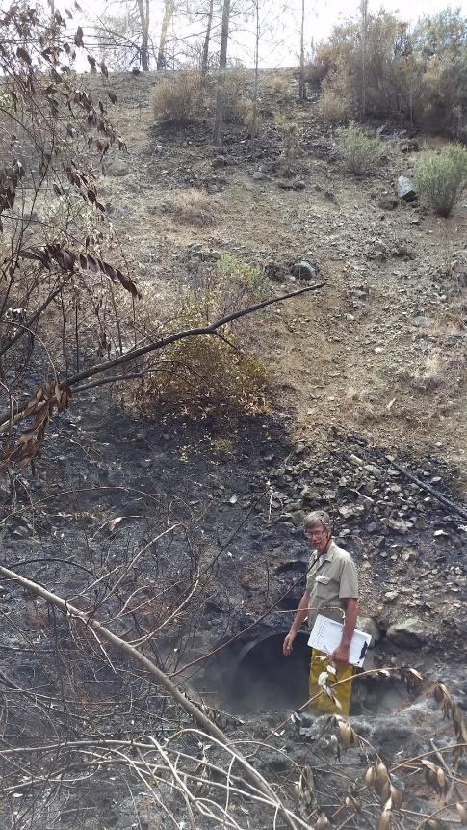
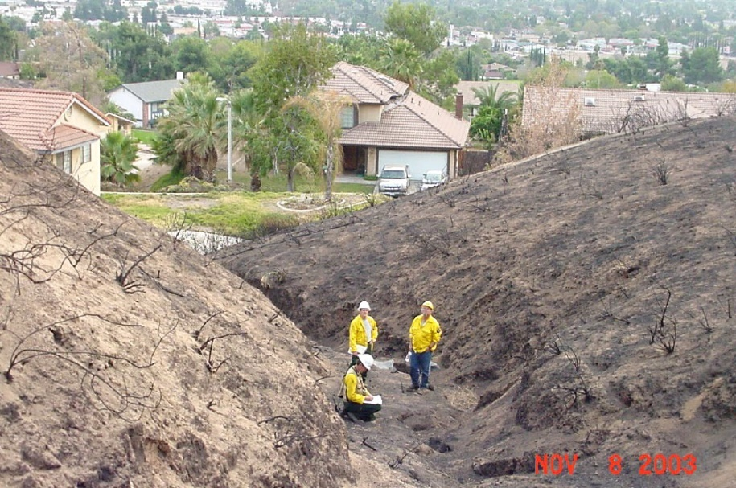
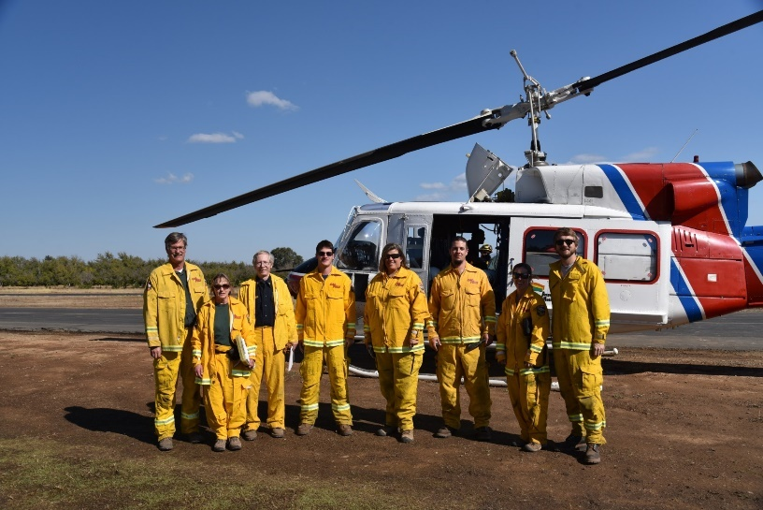
WHAT DO WE DO?
AFTER AN INCIDENT
WATERSHED EMERGENCY RESPONSE TEAM
Post-fire watershed restoration/recovery
CALFIRE

Slide 19
THANK YOU!!
DAVID HAAS
CAL FIRE
SAN BERNARDINO UNIT FORESTER
(909) 253-6632
David.Haas@fire.ca.gov
CAL FIRE

